Slide 1
Sun’s AS/400 Market Opportunity
Peter Kastner
EVP Platforms
Aberdeen Group, Inc.
Notes:
Introduction
Sun Microsystems asked Aberdeen Group to assess the attractiveness of IBM’s AS/400 and iSeries market, and to recommend how Sun might profitably attack the iSeries market.
The iSeries is the current incarnation of proprietary AS/400 midrange server family launched in 1988. This server family has seen over 750,000 units sold in 14 years, and contributed untold billions in profits to IBM. We use the AS/400 and iSeries terms synonymously throughout the report.
This report is the result of Aberdeen’s research project. The Aberdeen Group estimates, analysis, and recommendations contained in this report are confidential to Sun Microsystems, and may not be made public without the written permission of Aberdeen Group, Inc.
Presentation by Peter Kastner kastner@aberdeen.com (617) 854-5221.

Slide 2
Agenda
AS/400 Demographics
Competitive Assessment
IBM’s 2002 Game Plan for iSeries
Market Opportunity for Sun
Recommended Market Strategy
Discussion
Notes:
The content of this presentation is from Aberdeen Group’s report to Sun management, April 20, 2002 entitled Competing for the AS/400 Market

Slide 3
AS/400 Demographics
BIG: 450,000 machine installed base – 25,000 are current products and OS release
$7.7B hardware & $2.6B software = 23% of IBM’s hardware revenues
Five-year decline in revenue from $13.5B Y2K
IBM says addressable market is $56B
Europe is as important as North America
Typical customer skewed low: 1-2-way @ $50-150K
Notes:
Demographics and Market Conditions
• The AS/400 installed base is 450,000 machines, of which approximately 25,000 are running the latest OS/400 release on currently offered hardware.
• We estimate that in 2001 the iSeries hardware generated $7.68 billion in revenue representing 23% of IBM’s hardware revenues, and $2.59 billion in software representing 20% of 2001 software revenues. This makes the iSeries a $10.27 billion business for IBM. We estimate a gross margin contribution of $7.2 billion — and a COGS of 30%.
• Revenues have declined approximately 25% since the pre-Y2K peak in 1998 at $13.5 billion. Erosion is caused by deliberate server consolidation, competition at price-sensitive accounts by Windows NT, and replacement by more modern applications (e.g., Siebel and SAP). However, the revenue decline should not be taken as a sign that the iSeries base is ripe for picking. Growth is coming in emerging markets (China), mergers and acquisitions, an expanding partner-driven distribution system, deeper penetration into the SMB market, and
• IBM believes the iSeries has an addressable market of $56 billion (Table 3). Based on our estimates, IBM is capturing 18.3% of this addressable market.
• iSeries is focused at specific vertical markets through business partners who complete 85%+ of transactions. Key verticals which represent 55% of sales are manufacturing, finance, and whole/retail (distribution) (Table 4).
• Besides a vertical focus, IBM is currently focusing on new-application upgrades with business partners: CRM, ERP, SCM, and B2B.
• IBM sells the iSeries globally. We estimates 2001 hardware and software revenues in North America at $3.96 billion, EMEA at $4.0 billion, and Asia/Pacific at $2.3 billion.
• The typical customer has a one- or two-processor system (value $50K-$150K), representative of a small-medium business (SMB) with fewer than 1,000 employees. To that SMB customer, the iSeries is their “mainframe”.

Slide 4
iSeries Competitive Assessment
Sun overlaps the iSeries product line
  iSeries: 1-32 way servers @ 400-375,000 TPM-C
Exceptional partner program: 85% of revenues go through partners; solutions focus
Good commercial OS and middleware
Poor price-performance, pricey upgrades
Positioning & messages well tuned to SMB
Europe is the key SMB battleground
Notes:
Competitive Assessment
• The iSeries has five models scaling 500-fold from roughly 400 TPM-C (model 250) to 375,000 (model 890), with base prices starting under $10,000 (more like $15,000 configured) (Table 9). Full complement of peripherals. Native support for IBM’s eBusiness infrastructure. Good ability to manage Intel-based servers. OS/400 is a mature commercial operating system with an embedded (object-)relational database. No obvious gaps that Sun could exploit with the exception that IBM in general is not offering Linux-based appliances.
• The iSeries benefits from one of the industry’s leading business partner programs, empowering partners around the globe with incentives and marketing. The ISV partner program over fifteen years has resulted in thousands of specialized applications. Partners are also a key component of the service and support infrastructure, typically providing first-level support.
• There is a mature and broad set of application development tools from IBM and partners for the development of modern eBusiness applications using Web infrastructure as well as legacy, dumb-terminal applications.
• Price-performance is relatively poor as the iSeries is premium-priced, particularly on upgrades. However, customers are generally satisfied with TCO since the iSeries is easy to operate and administer (e.g., no Oracle DBA required).
• Europe is the key battle ground. Any iSeries program of Sun must have a large investment in understanding and attracting IBM’s targeted European SMB market.
• To the SMB buyers who want IBM to provide solutions, the iSeries positioning and messages are well crafted, tested, and working (Table 8).

Slide 5
IBM’s 2002 Game Plan for iSeries
Server consolidation (recentralization)
Upgrade e-infrastructure (Notes & WebSphere)
Competitive Target: HP3000 migration
SMB new-market growth
Enterprise Application Solutions
Selectively target SMB (under 100 employees)
Replace or refinance Y2K-era machines
Notes:
IBM’s 2002 iSeries Game Plan
• Server consolidation: replace old AS/400s and centralize.
• Upgrade e-infrastructure: IGS-driven WebSphere.
• Competitive Target: HP3000 end of life migration
• SMB new-market growth: Notes Domino, portals, and mid-market ERP with Navision business partner.
• Enterprise Application Solutions: modernize customer applications in CRM/BI, ERP, and SCM.
• Selectively target small business market (under 100 employees).
• Replace or refinance Y2K-era machines.

Slide 6
Avoid a Direct Assault on AS/400 Base
No identifiable class of dissatisfied iSeries users
Unix and Windows migration already exists
Most of the installed base is low/no growth
  “IT is an expense, not a competitive weapon”
  “I’d rather fight than switch”
IBM is doing enough to keep the iSeries close to the technology edge
  Linux, NT, web, Notes, POWER4 …
Notes:
Installed Base Migration is an Unattractive Market
iSeries customers leaving the IBM installed base are not covered in the addressable market above. First, we do not observe an identifiable class of dissatisfied iSeries users, so we cannot define an addressable market. Second, iSeries attrition to other platforms is already addressed by Unix and Windows NT competitors, so those sales are already being counted. Third, 75% of the installed base is in a low-growth/no-growth state of inertia. These customers are happy with their AS/400s and see little need to upgrade, let alone switch to Sun.
Any Sun attack on the AS/400 base should be targeted to particular classes of buyers.

Slide 7
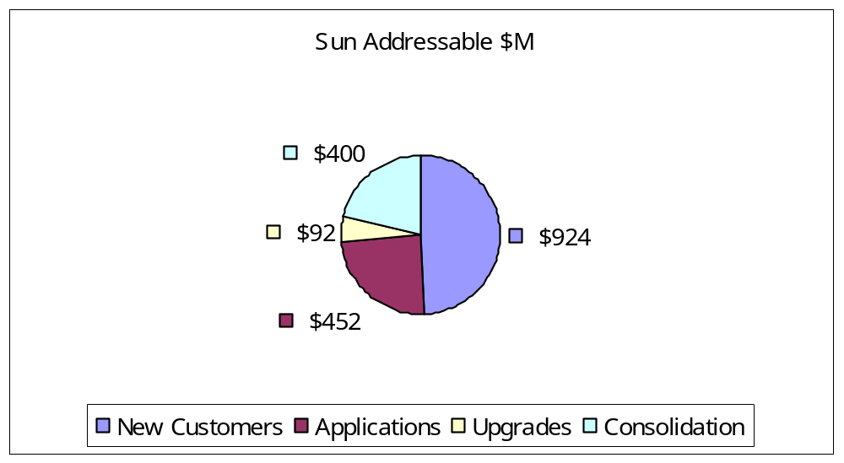
Market Opportunity for Sun
New customers
Applications – CRM, EAS, SCM, B2B
Upgrades – fight for Linux
Consolidation
Notes:
Sun's Addressable Market and Opportunity Size
Table 13 depicts in tabular form Aberdeen’s analysis of the market opportunity and sizing for Sun based on flat IBM revenues for the iSeries in 2002 at $10.27 billion. Our conclusion is that the addressable market for Sun in 2002 is $1.87B:
• New Customers — represent 10% of iSeries revenues, $1,027M. We believe Sun can address 90% of this market, yielding an addressable market of $924M.
• Consolidation — represents 6% of IBM iSeries revenues. We believe 65% is addressable by Sun, yielding an addressable market of $400M.
• Applications — CRM, EAS, SCM, and B2B represent 11% of iSeries revenues. We believe that 40% is addressable, yielding an addressable market of $452M.
• Upgrades — Hardware and software upgrades related to Linux and xSeries management are estimated at 3% of revenues. This is the only portion of iSeries upgrades we find attractive. But selling Sun platforms as upgrades into iSeries shops is a low yield proposition, so we estimate only 30% is addressable — yielding $92M in addressable market for Sun.

Slide 8
Prioritized Market Strategy
New customers
Applications – CRM, EAS, SCM, B2B
Upgrades – fight for Linux
Consolidation
Notes:
Recommended Market Strategy for Sun Microsystems
Aberdeen Group’s recommended market strategy is to target selected segments of the iSeries market, as identified in the Addressable Market Opportunity. These are prioritized:
1. New Customers
IBM wins new customers through its worldwide business partner organization. Sun has been and is already competing for these sales. Follow IBM, and partner with a selected set of IBM’s partners (e.g., Sun at J. D. Edwards).
2. Applications — CRM, EAS, SCM, B2B
IBM, Sun, and Aberdeen all believe there is an attractive market for enterprise applications encompassing customer relationship management, ERP and enterprise applications, supply chain management, and business-to-business Internet infrastructure. IBM’s present target is the small-medium business segment of this market. Aberdeen believes Sun should counter this program with its own.
3. iSeries Upgrades — Linux is the Lever
In Table 13, we show the addressable market for upgrades as 3% of revenues, worth $308 million, whereas the total upgrades market is more than an order of magnitude greater. Sun cannot compete for the typical memory, CPU, or storage upgrades. Sun can compete for Linux and Linux appliance business, with a projected capture of $92 million. IBM supports Linux on the iSeries as a guest OS. But IBM has done a poor job of packaging Linux with appliance functionality. We believe the overall enterprise level of interest in Linux, and the number of Linux-based applications, will skyrocket. Sun’s market opportunity is to offer Linux to iSeries customers as an alternative to IBM’s OS upgrade.
4. Consolidation
Consolidation often means centralizing small, distributed AS/400 system workloads back to a central data center. Sun is well positioned for enterprise-class, mission-critical commercial computing. A key technology and services issue will be the ability to migrate existing applications off of the AS/400 and onto Solaris, but Sun has considerable experience in its successful mainframe migration program.

Slide 9
New Customers
Attract IBM’s partners (JDE, Siebel, SAP, Intentia, Navision…)
Find where the new installs are going (e.g. Asia banks). Target verticals.
Value prop:
  Better value and more choice than pricey IBM
  Better future-proofing than OS/400
  iForce is solutions focused too

Slide 10
Applications — CRM, EAS, SCM, B2B
“Freeze your AS/400. Go with Sun for new business apps and Edge (H1)”
Sun is already competing in the apps market
Value Prop:
  Better value and more choice than pricey IBM
    Do a TCO analysis of new Sun vs. upgrade
  Better future-proofing than OS/400
  Solaris business apps are Tier 1, not Tier x
    Get latest technology faster with Sun
  There is a better way than IGS -- iForce

Slide 11
iSeries Upgrades — Linux is the Lever
Most AS/400 upgrade business is unattainable
Opportunity is to compete for Linux-related upgrades of CPU, memory, disk with Sun Linux on SPARC or Intel
Value Prop
  Much better value than expensive iSeries cycles
  Very manageable (Cobalt appliance manager)
  Tier 1 Linux apps on Sun, not on IBM
  Sun has Cobalt Linux appliance solutions. IBM does not.

Slide 12
Consolidation
Catch large accounts who are re-centralizing geographically distributed computing on a large host server
Carefully target consolidation characteristics
Key Issue: ability to run existing dumb terminal/RPG apps, at least for awhile. Must create a Blue Away-like program.

Slide 13
Discussion

